Slide 1

Computational Text Analytics Term Project
Dominic Polletta & Joey Polletta

Slide 2
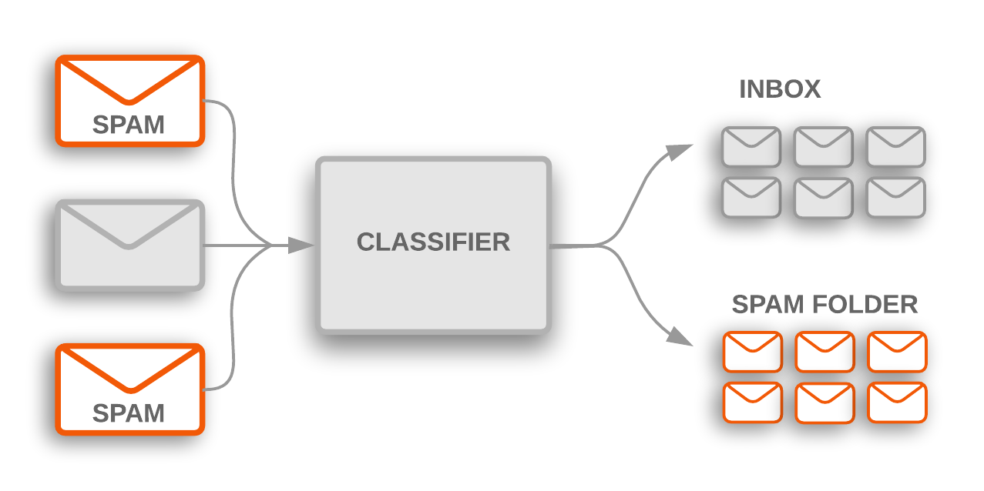
Problem Definition
Our objective was to take the abstracts from PubMed and use different machine learning models to classify them
We expected that many of the difficulties would be due to the machine learning models
Instead, much of the difficulties came from technical issues and pre-processing the data

Slide 3

Acquiring Abstracts
The library we used to access PubMed is called BioPython
Bio Python utilizes functions that directly interface with the PubMed API
The biggest issue with this stage of the project was the documentation
In the end, the best way to deal with the errors was to just ignore them
We ended up with a CSV file generated from the abstract texts

Slide 4

Getting Data Ready for Machine Learning models
We took the CSV file from the abstract generation and then applied standard normalization practices
We then took these normalized abstracts and used BOW for our feature representation
We took the BOW representation and transformed it into a Pandas DataFrame representation
Using the SKLearn Train_Test_Split method, we separated our data into our training and testing sets. These sets were shuffled to ensure a fair distribution of all classes
Notes:
Preprocessing
Text Normalization
BOW Representation
W2V explanation
Dataframe
List of dictionaries method
NaN removal
Train-test split
42 shuffles
7:3 Train to test split

Slide 5
Algorithms Employed
Once we had our Train_Test_Split, we were able to use SKLearn to do a lot of the machine learning heavy lifting
By taking our training features and targets from the split, we were able to use the Fit method from SKLearn to feed the training data to each of our machine learning models
Since the Train_Test_Split and all of the models are from the SKLearn package, from this point it was plug and play
Notes:
Dataframe to ML
Naïve Bayes, just plug in
SVM, just plug in
One vs Rest
One vs One
Logistic Regression, just plug in
Humorous Aside: Linear Regression is NOT logistic regression
All are part of SKLearn, making it easy to plug and chug

Slide 6
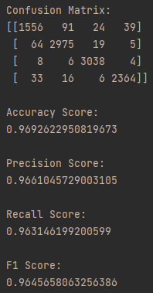
Naïve Bayes
Difficulties/Downsides
Requires prior knowledge
Assumes all features are independent
Requires smoothing to avoid zero frequency
Advantages
Relatively quick
Computationally light
2nd best accuracy and best time
Time to Run: 00:15:29.5

Slide 7
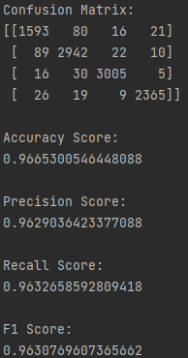
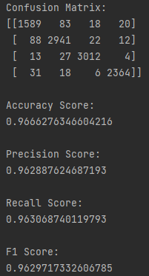
Support Vector Machine
One vs Rest
One vs One
Difficulties/Downsides
Not good for large data sets
Isn’t best at accuracy or time
Takes a lot of memory to execute
Advantages
Good for when the classes are easily separable
Good middle ground between Naïve Bayes and Logistic Regression
Works better with multiclass labeling
Benefits from Word2Vec representation
Time to Run: 00:27:21.9
Time to Run: 00:27:35.1

Slide 8
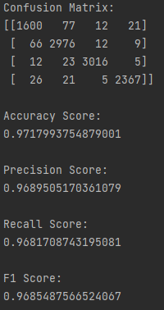
Logistic Regression
Difficulties/Downsides
Not good for non-linear functions
Significantly longer run time than either option
Advantages
Not likely to over-fit
Best accuracy overall, 97.1% vs next highest of 96.9%, as well as best F1 score
Time to Run: 00:31:13.9

Slide 9
Conclusions and Outlook
Conclusions
Naïve is 2nd best in accuracy, 1st in speed
SVM is overall the worst option, offering slightly less accuracy at more time compared to Naïve Bayes
Logistic Regression is best in accuracy, worst in speed
Overall, the difference at this scale is incredibly small. With larger datasets, the differences will be pronounced but at this stage the difference is negligible
Outlooks
We now have a baseline reading for different machine learning models on medical journal abstracts. There several avenues for expanding our efforts, such as attempting the same tests but with different types of texts such as social media posts. Another avenue would be to use Word2Vec instead of Bag Of Words, or to attempt using more types of machine learning models to further evaluate.

